Slide 1


Reconfigurable Computing for Higher Order S-Curve Motion Control
Pomona
By: Bryan Banta
Hao Luc
Spencer Moore
Brian Tapia
John Villegas
Adviser: Dr. Mohamed El-Hadedy
Electrical and Computer Engineering Department
May 1, 2020

Slide 2
Table of Contents
Introduction to S-Curve Motion Control
Applications
Objectives
S-Curve Characteristics
Hardware
Block Diagrams
Project Schematic
Demo
Data
References

Slide 3
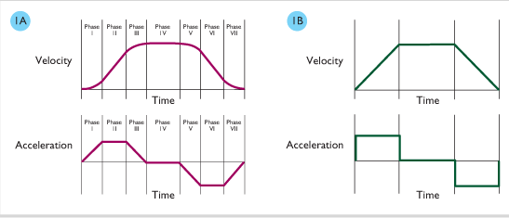
Introduction to S-Curve Motion Control
What is it?
Notes:
S curve is a type of motion profile that produces a higher order velocity curve by limiting jerk to a fixed value as opposed to a trapezoidal motion profile where jerk is infinite. It limits vibration in a movement reducing wait time for stability of end position. This motion profile is useful for applications where accuracy of high-speed motions are critical.

Slide 4

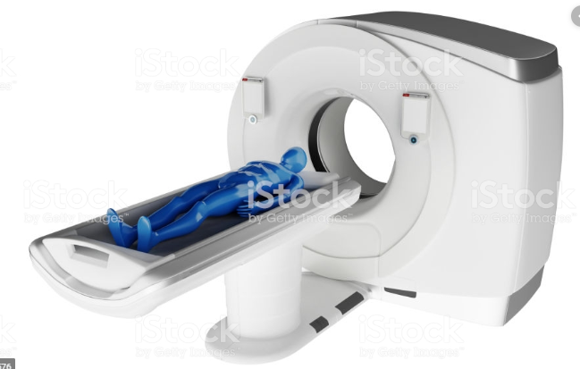
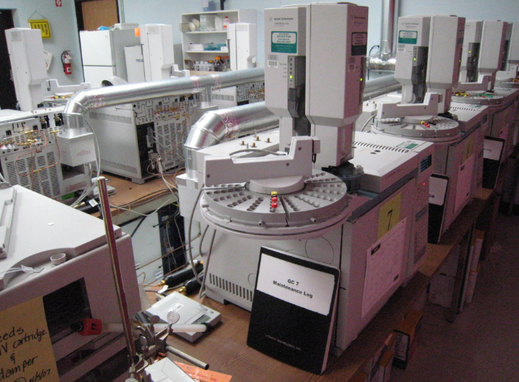
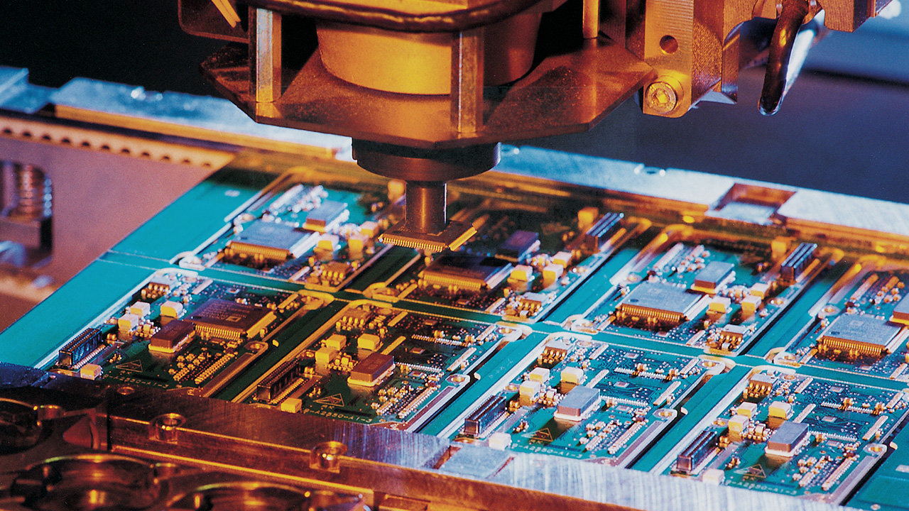
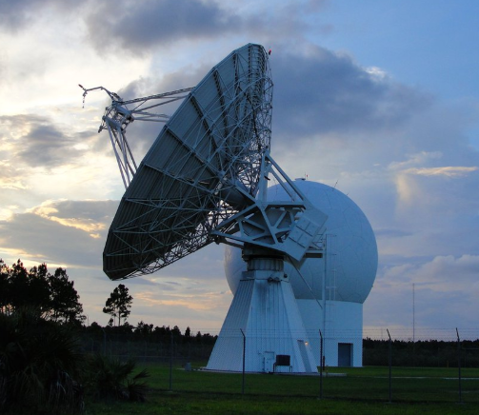
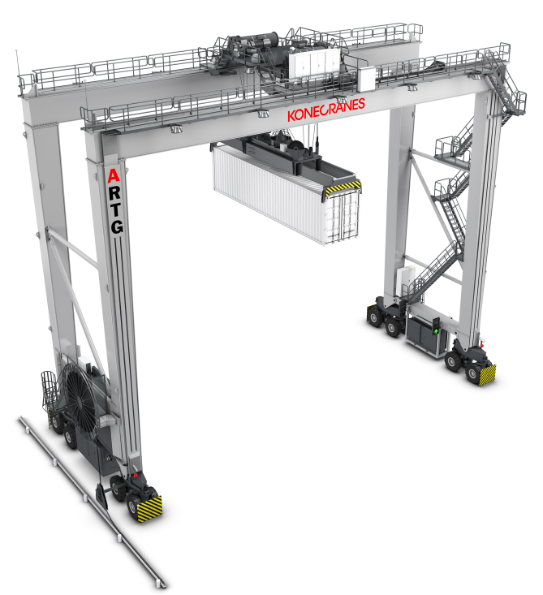
Applications
Elevators
Chemical Analysis Automation
Human Diagnostic Scanners
SemiconductorComponent Manufacturing
Automated Gantry Systems
Antenna/Tracking Systems Control

Slide 5
Objectives
Implement both Second Order S-Curve and Third Order S-curve motion control.
Apply S-curve motion control on two-dimensional movements.
Measure jerk using accelerometer and compare values for both orders of S-curve motion control.

Slide 6
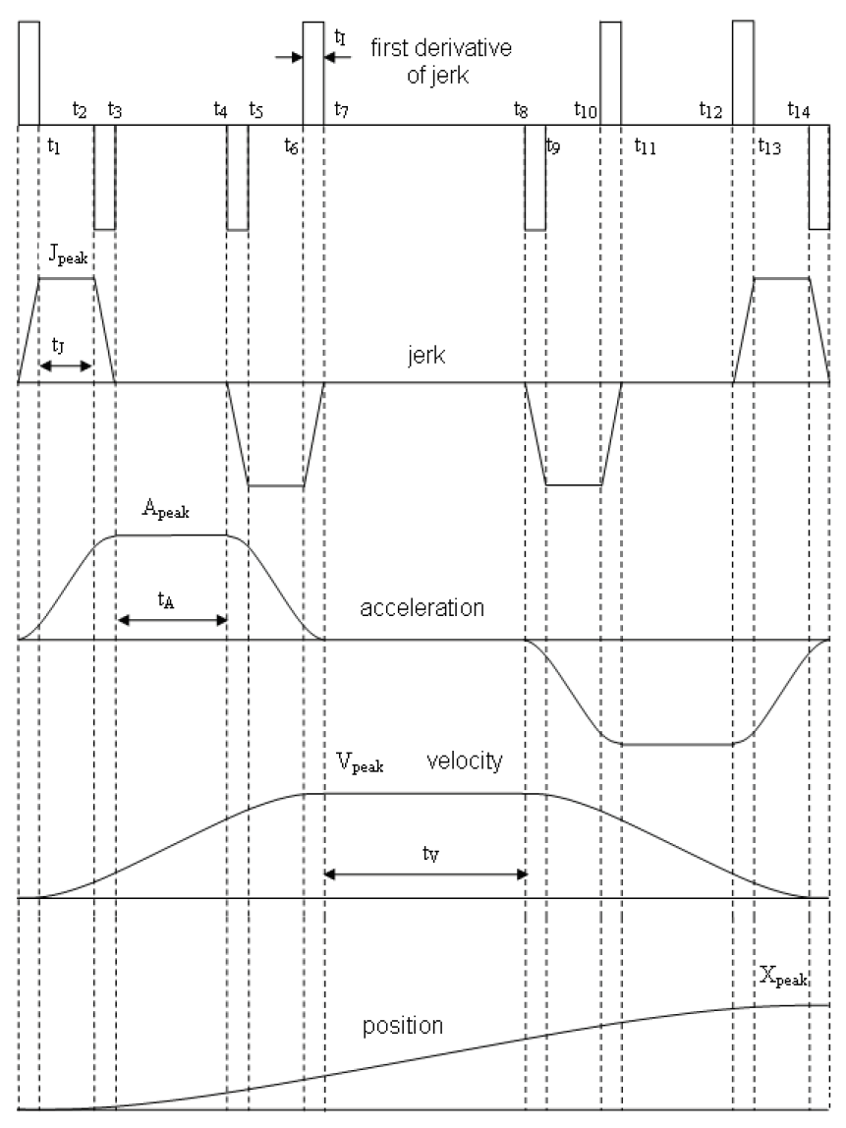
S-Curve Characteristics

Slide 7
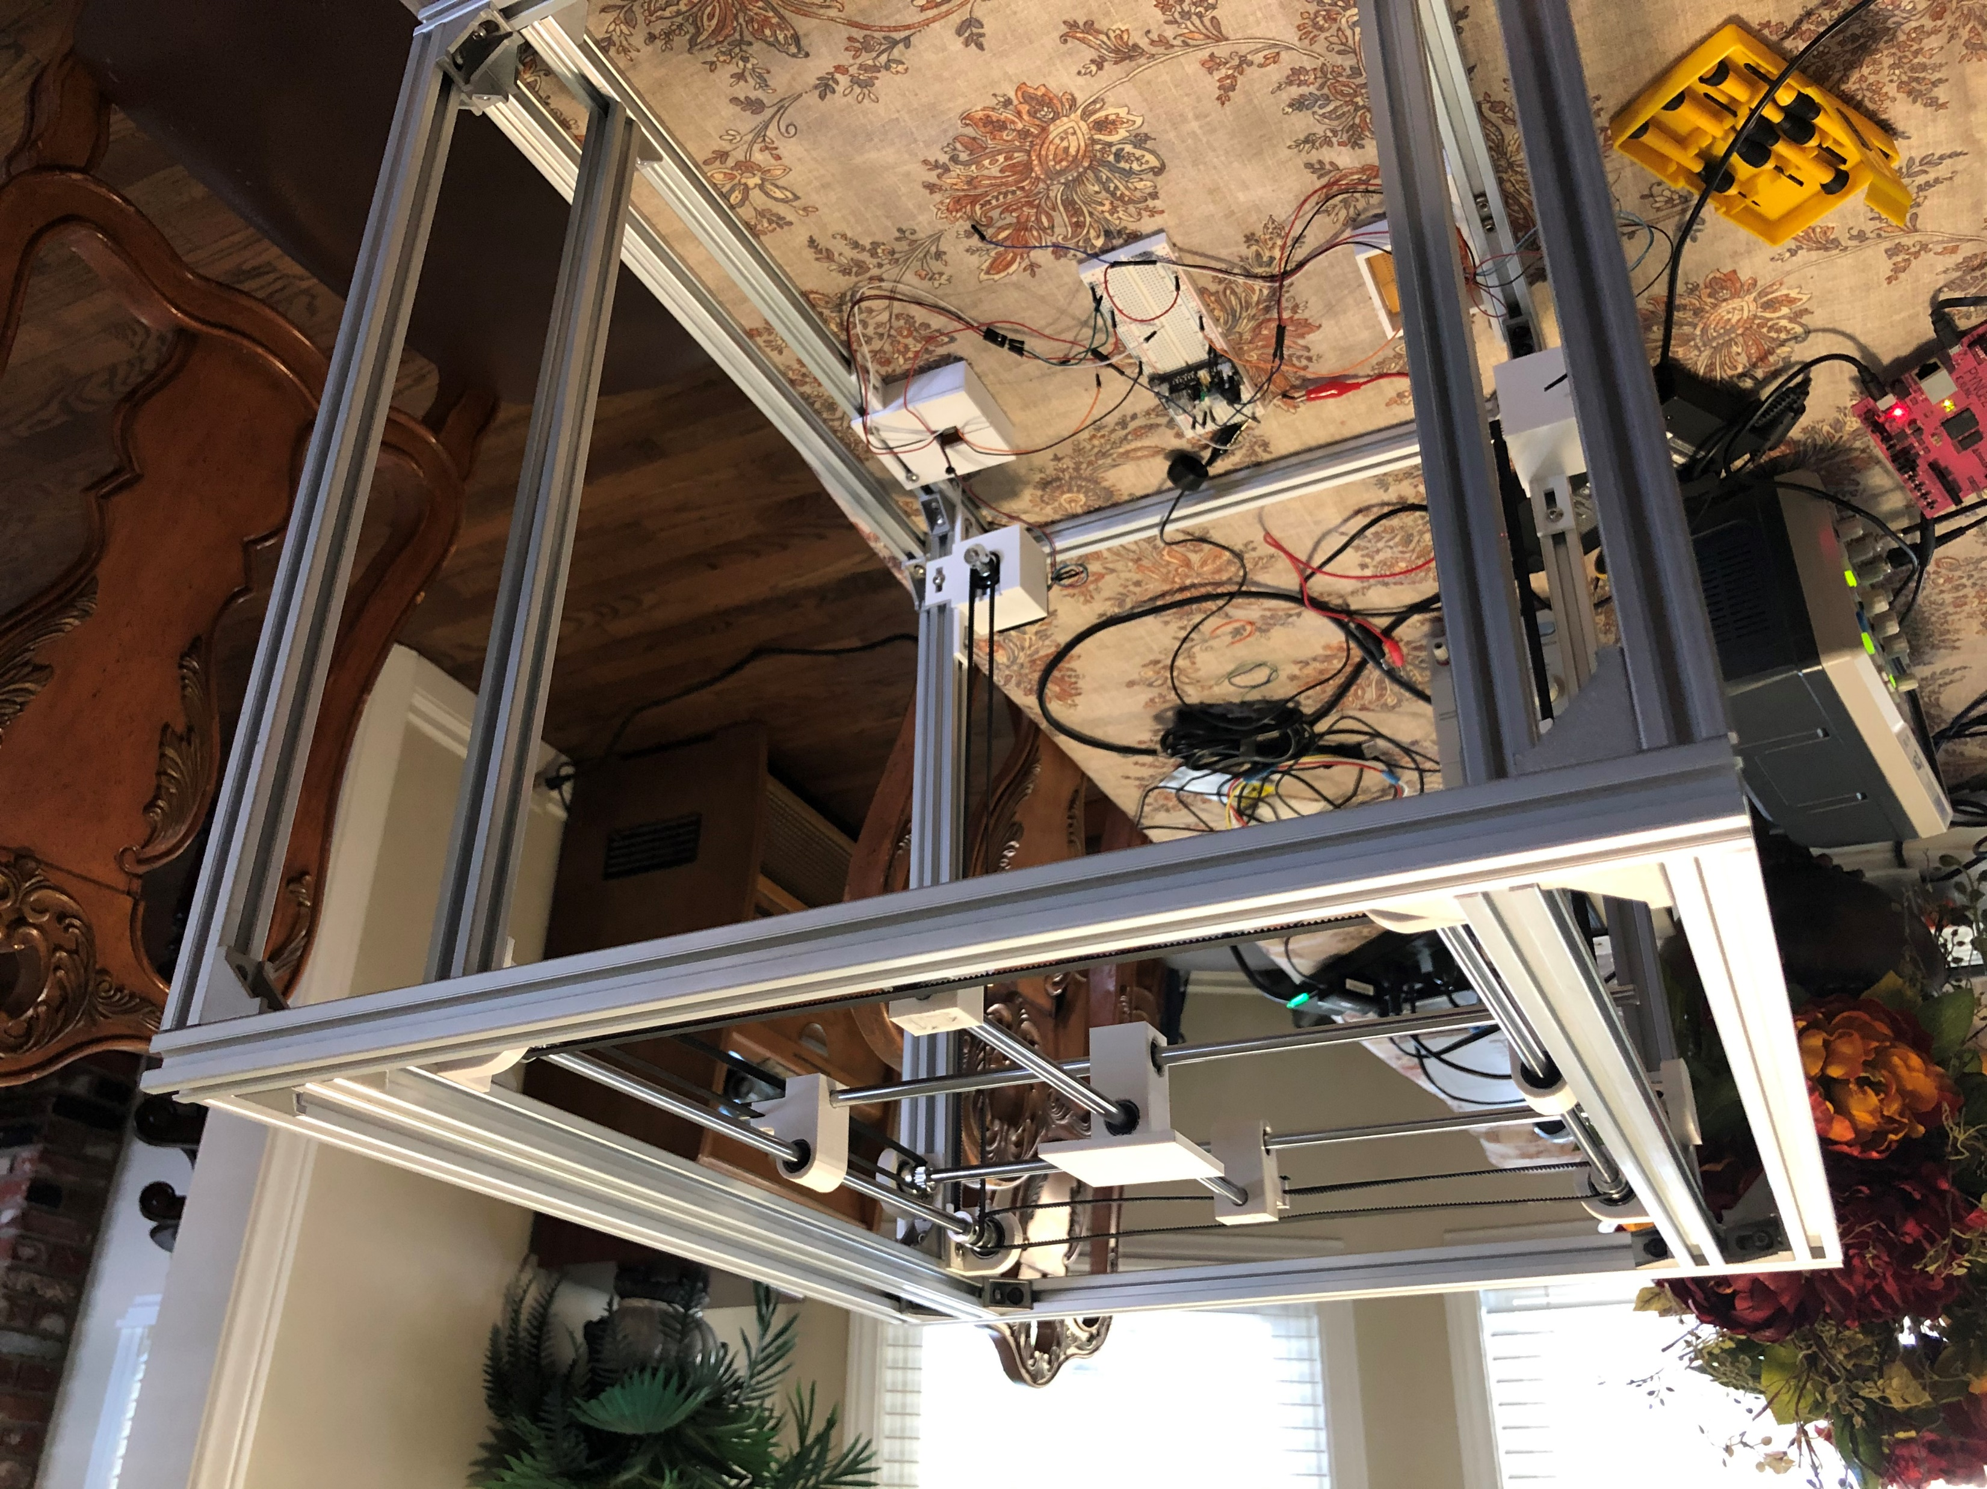
Hardware Design
Notes:
Hi, my name is John and I will be discussing about the design of the moving platform for the S-Curve Motion Control. As you can see from the slide, the design for our moving platform is inspired from the design of 3D printers that enthusiasts use. Due to that, most of the parts used such as the aluminum extrusions, and the precision rods are purchased readily from online retailers such as Amazon. Now, in order to reduce cost, a lot of the parts such as the center carriage, the enclosures for the motor and the rod fasteners are 3D printed. Aside from reducing costs, 3D printing also helped a lot with issues of improper fitting.

Slide 8
Project Block Diagram
Microblaze
S Curve
Configurator
AXI BUS
AMBA INTERCONECT
IP Clock
AXI BUS
Pulse Generator
S Curve Block
ZYNQ Programable Logic
ZYNQ Process System

Slide 9
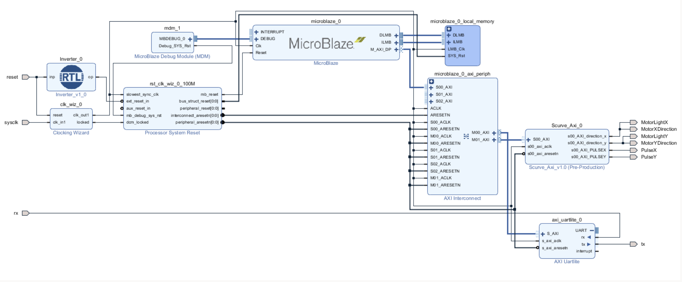
Vivado Block Diagram

Slide 10
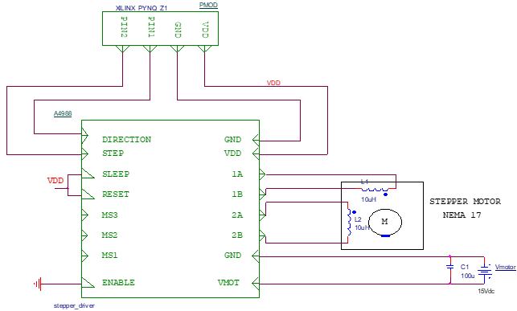
Project Schematic

Slide 11
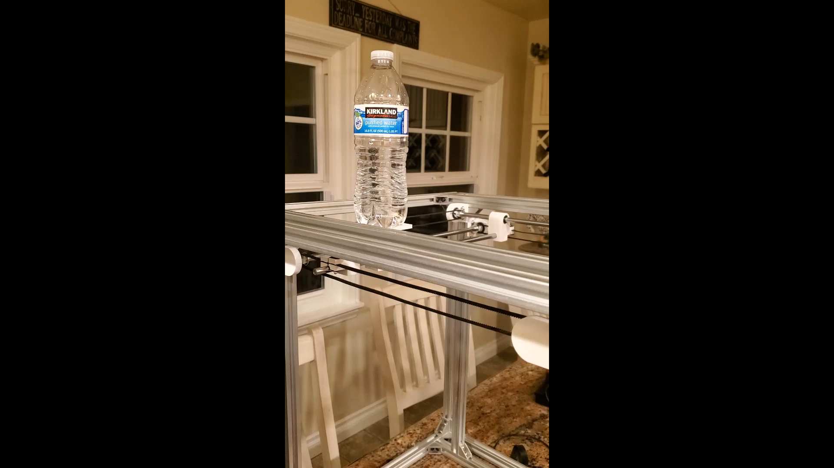
Demo

Slide 12
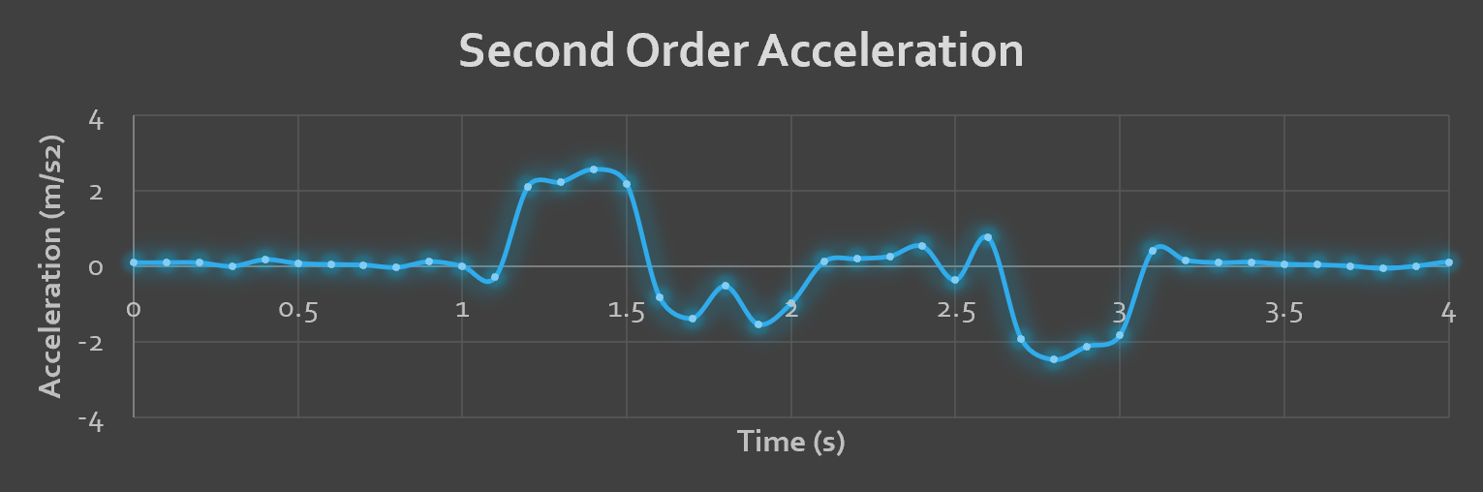
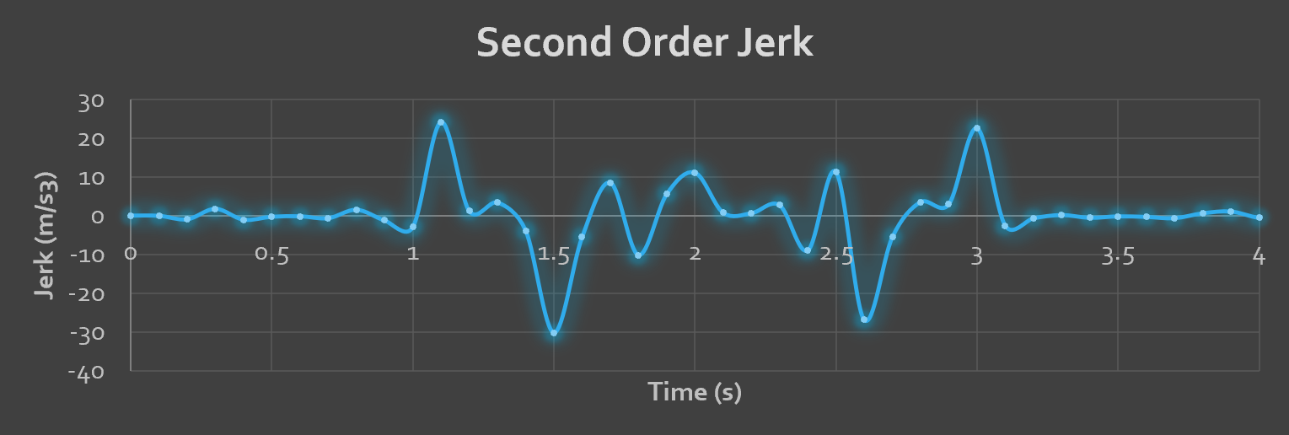
Accelerometer Data
Notes:
Hi, this is John again and I will be discussing our data for both orders of S-curve motion Control. To determine the effectiveness of the S-curve algorithm, an accelerometer was mounted on top of the center carriage and acceleration values were obtained for both X and Y direction. The resultant acceleration was then obtained and plotted into a graph. As observed from the slides are two graphs. The first graph shows the second order acceleration. As observed, the movement starts and ends with an acceleration curve resembling a plateau. Jerk is then calculated from the acceleration data points to which we can see a set value of jerk at the start and at the end of the motion.

Slide 13
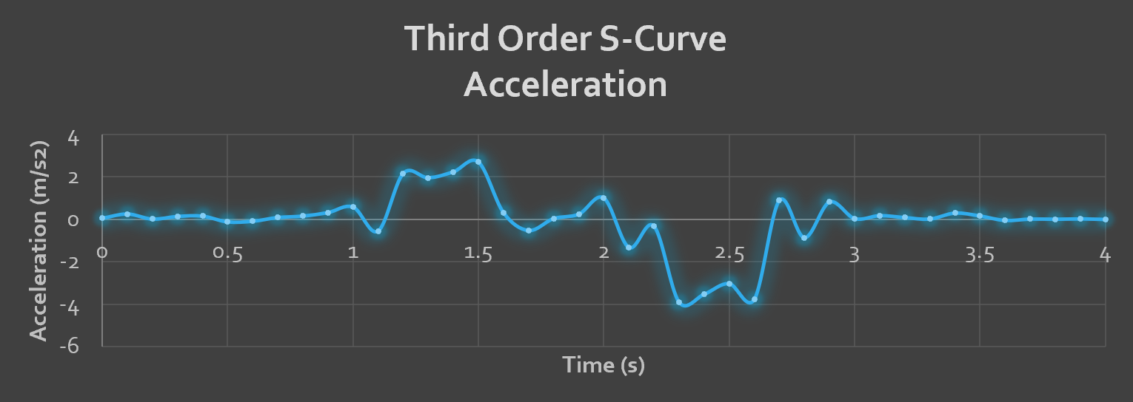
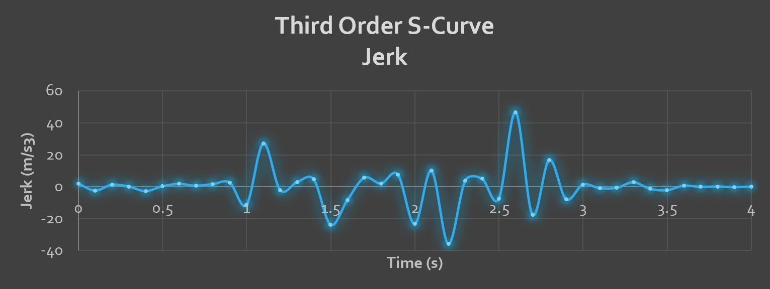
Accelerometer Data
Notes:
In this slide, we can see the acceleration for the Third Order S-curve. As observed the acceleration curve is similar in pattern compared to the Second Order curve. The same goes for the jerk as well.

Slide 14
Results
Constructed custom hardware platform to test our design
Developed code to apply Scurve Motion profile
Second and Third Order results
Notes:
Overall, we implemented an S-curve motion controller in a PYNQ board and from the data gathered, both the Second and Third Order S-Curve produced a finite value of jerk as opposed to a trapezoidal profile that produces an infinite amount of jerk. Although, there is no discernable difference in acceleration and jerk between the Second and Third Order S-curve.

Slide 15
References: (Bibliography)
Lewin, C. (1994). Motion control gets gradually better. Machine Design, 66(21), 90. Retrieved from http://proxy.library.cpp.edu/login?url=https://search-proquest-com.proxy.library.cpp.edu/docview/217145850?accountid=10357
Lewin, Chuck. “Mathematics of Motion Control Profiles.” Performance Motion Devices, www.pmdcorp.com/resources/type/articles/get/mathematics-of-motion-control-profiles-article.
Nguyen, K. D., Ng, T., & Chen, I. (2008). On Algorithms for Planning S-Curve Motion Profiles. International Journal of Advanced Robotic Systems, 5 (1), 11. doi:10.5772/5652
Vivado Design Suite, ( 2017) . "Processing System 7 v5.5 LogiCORE IP Product Guide" https://www.xilinx.com/support/documentation/ip_documentation/processing_system7/v5_5/pg082-processing-system7.pdf

